Slide 1
Booth Multiplication
As in all multiplication schemes, booth algorithm requires examination of the multiplier bits and shifting of the partial product. Prior to the shifting, the multiplicand may be added to the partial product, subtracted from the partial product, or left unchanged according to following rules:
The multiplicand is subtracted from the partial product upon encountering the first least significant 1 in a string of 1’s in the multiplier
The multiplicand is added to the partial product upon encountering the first 0 (provided that there was a previous ‘1’) in a string of 0’s in the multiplier.
The partial product does not change when the multiplier bit is identical to the previous multiplier bit.

Slide 2
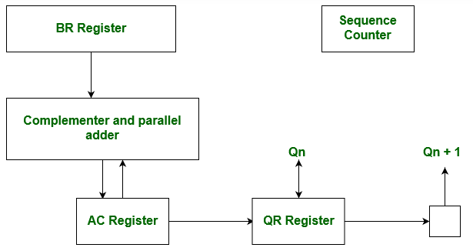
Hardware Implementation of Booths Algorithm
The hardware implementation of the booth algorithm requires the register configuration shown in the figure below.
Multiplicand is stored in BR and Multiplier is in QR. Qn represent the least significant bit of multiplier in the register QR. An extra flip-flop Qn+1 is appended to QR to facilitate a double inspection of the multiplier.

Slide 3
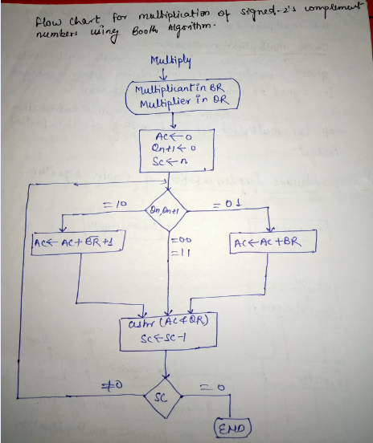
Booth’s Algorithm Flowchart –

Slide 4
AC and the appended bit Qn+1 are initially set to 0 and the sequence SC is set to a number n equal to the number of bits in the multiplier.
The two bits of the multiplier in Qn and Qn+1are inspected as follow
i. If the value of Qn and Qn+1 is 10, then multiplicand (BR) is subtracted from the partial product in AC
AC<-AC+BR’+1 (AC+2’s Complement of BR)
ii. If the value of Qn and Qn+1 is 01, then multiplicand (BR) is added to the partial product in AC.
AC<-AC+BR
iii. If value of Qn and Qn+1 is identical (00 or 11), then the partial product does not change.
iv. After each partial product the AC and QR register are shifted to the right and SC is decremented by 1.

Slide 5
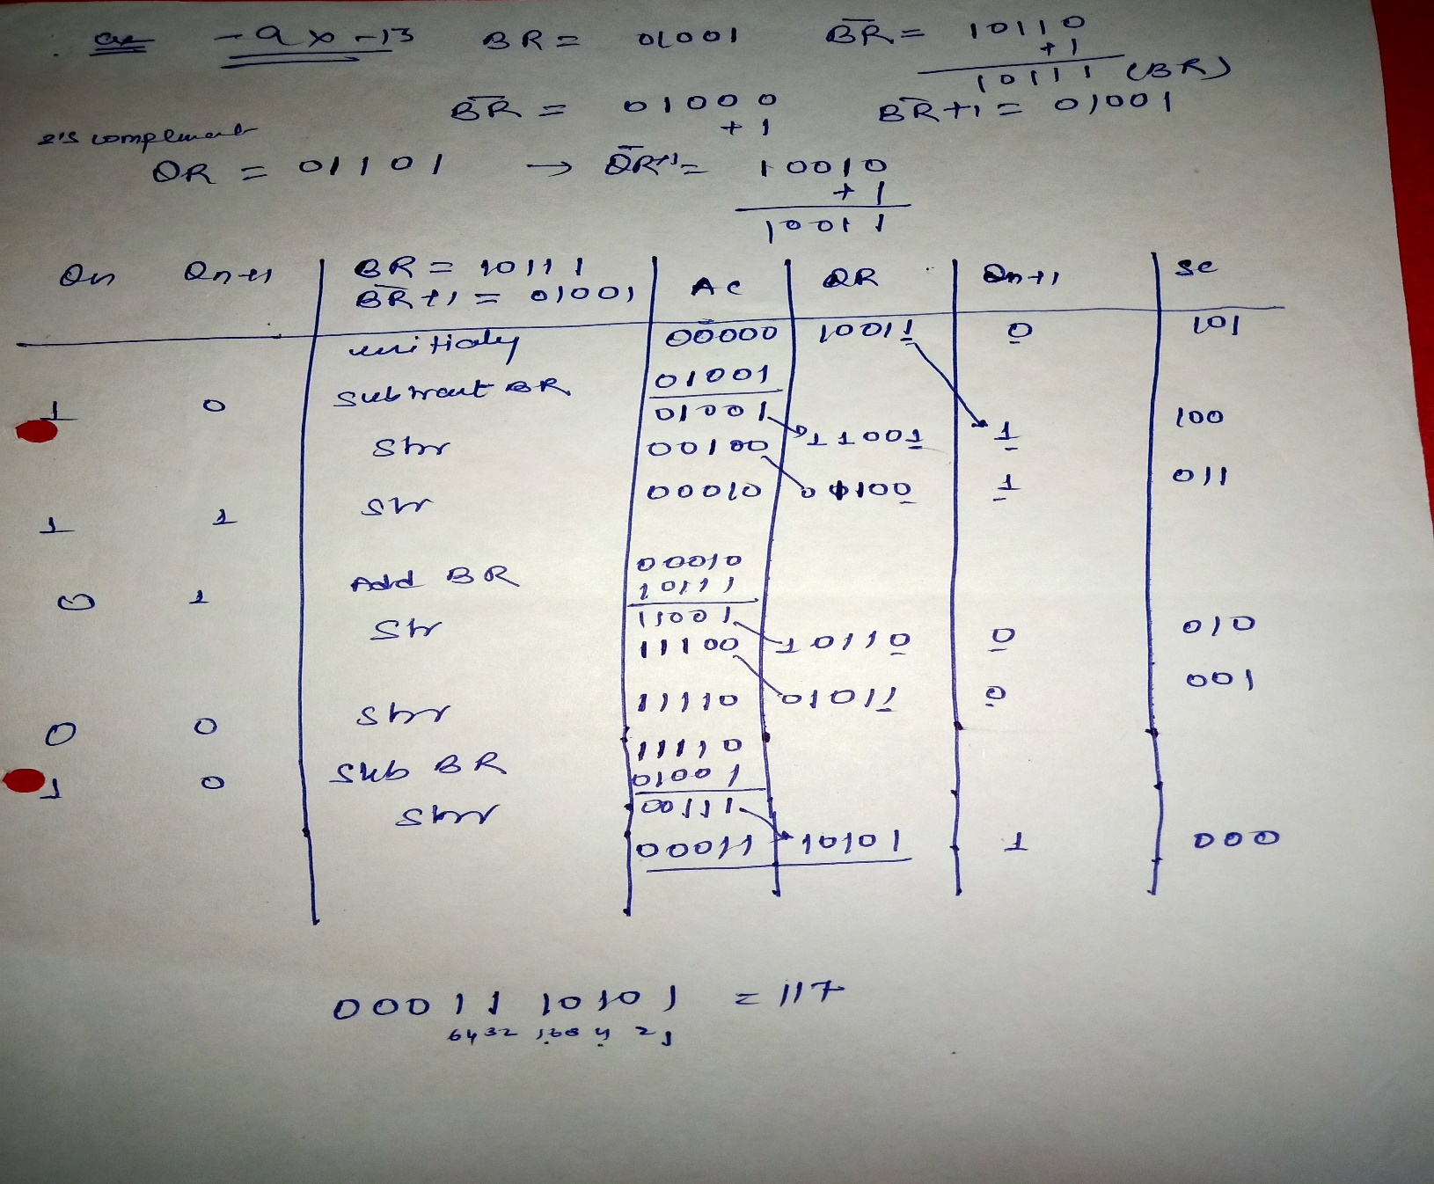
Example – A numerical example of booth’s algorithm is shown below for n = 5. It shows the step by step multiplication of -9 and -13

